Slide 1
REPORTING SKILLS
R. Rajeshkumar
Assistant Professor
Department of Visual Communication
Jamal Mohamed College (Autonomous)
Tiruchirappalli 620 020

Slide 2
REPORTING TECHNIQUES FOR DIFFERENT MEDIA

Slide 3
Reporting Skills can be learned, Just Like Any Other Skill. The Entire Reporting Process Involves
SETTING OBJECTIVES
DATA GATHERING AND ANALYSIS TOOLS
PLANNING
DRAFTING
EDITING
DESIGNING THE REPORT

Slide 4
REPORTING TECHNIQUES

Slide 5
INTRODUCTION
We use various media platform to find information. With technological advancement, we have more options or channels to get the news.
The news media can be broadly divided into four categories:
Newspaper
TV
Radio
Internet

Slide 6
WHY REPORTING FOR VARIOUS MEDIA DIFFER
The Print Media Relies More On Words And Photographs
The Television News Requires Visuals Or Videos
The Radio News Is Delivered In The Form Of Sound
The Online News Can Present The News Using All Word, Video, Audio And Photographs

Slide 7
News writing
News gathering
News process
Reporting
News presentation

Slide 8
who?
what?
when?
where?
why?

Slide 9
Types of Reporting:
1. Crime Reporting
2. Court Reporting
3. Health Reporting
4. Education Reporting
5. Political Reporting
6. Business Reporting
7. Science & Technology Reporting
8. Sport Reporting
9. Culture Reporting
10. Civil Administration Reporting

Slide 10
THE MAIN ELEMENTS OF NEWS
ODDITY
EMOTION
PROXIMITY
PROMINENCE
INTEREST

Slide 11
REPORTING FOR PRINT MEDIA

Slide 12
Taking notes in Reporting is very important!

Slide 13
Fairness Is The Foundation of Good Reporter
Fairness and balance is giving both sides of the picture, while fairness is not taking sides. It also means not providing support to political parties, institutions, communities or individuals, etc
Balancing Facts and Style
Readers need to know the facts and who or what may be affected by them. Related stories and background information make up the context and the emotional parts of the story show the human side of it.
Writing a Good Lead
The Lead Is The First Few Sentences Of The Story. It Needs To Be Strong So It Will Grab The Readers And Make Them Want To Read More.
Leads Need To Tell The Reader What The Story Is About And Why It Is Important.

Slide 14
Checking, verifying, analyzing &
interpreting information is extremely
important for a reporter.
Reporters Must Write Clearly And Effectively

Slide 15
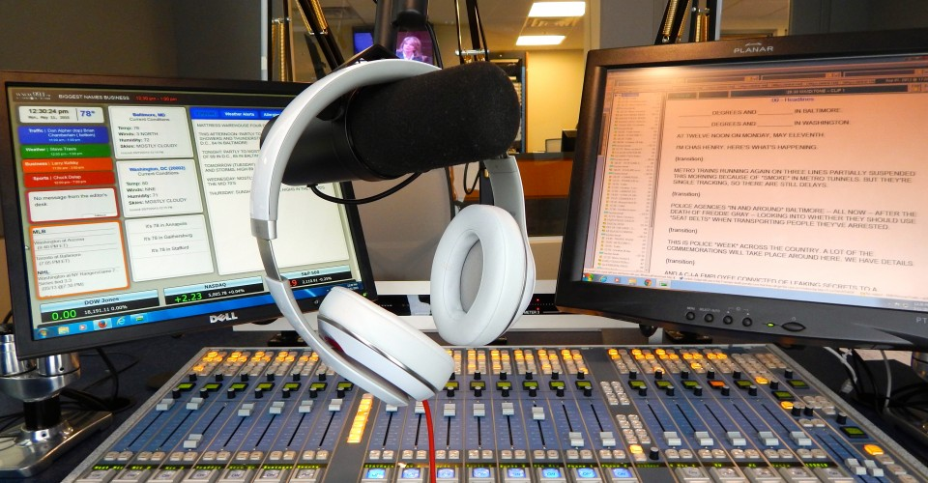
REPORTING FOR RADIO
Radio Is Oldest News Medium, After Print Media And Is Accessible To Wider Sections Of The Society. Even People Who Cannot Read Or Who Are Staying In The Remote Part Of The Country Can Access Radio News. It Is Available In Villages As Well As In Cities. According To UNESCO It Is “The Mass Medium That Reaches The Widest Audience In The World”.

Slide 16
Writing for Radio Keep it short and fast! Every second counts. Write short sentences with one basic idea in each. We are trying to cram information into peoples' ears, one short line at a time. Long, complicated sentences full of big words don't make you sound smart. Say what you mean, throw away all unnecessary words, and try to maintain a conversational style

Slide 17
REPORTING FOR TV NEWS
A television report begins with a general, simple sentence signalling the beginning of a story. It consists of reporter’s narration or voice over and video, which may include graphics, either static or animated.

Slide 18
Tv NEWS REPORTING
1. Straight news reports
2. Investigative or interpretative reports
Straight news reports present what has happened in a straightforward, factual and clear manner.
Investigative journalism is a kind of journalism in which reporters deeply investigate a topic of interest, often involving crime, political corruption, or some
other scandal.

Slide 19
INTERVIEWS

Slide 20
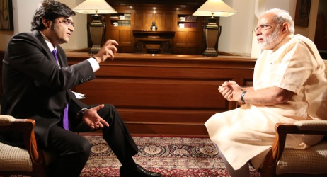
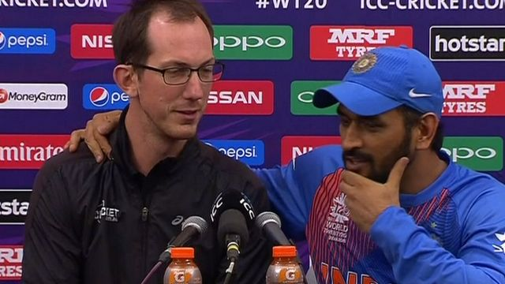
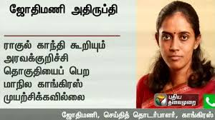
Different Types of Interviews
Written Interview
Specialized Interviews:
Press Conference Interviews
Telephonic Interview

Slide 21
REPORTING FOR WEB MEDIA

Slide 22
Online Media Can Reach A Very Wide Audience And Offer Enormous Space For News Writing.
Online Media Multiple Levels - Words, Ideas, Story Structure, Design, Interactive, Audio, Video, Photos, News Judgment – Should Be Considered At Once. TV Is About Showing The News. Print Is More About Telling And Explaining.

Slide 23
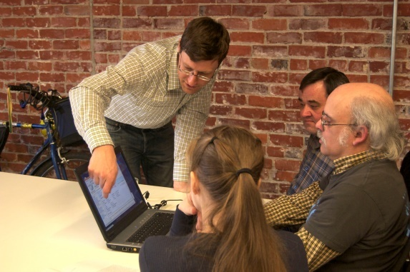
Online Is About
Showing
Telling
Demonstrating
Interacting

